Slide 2


Security
Presented by
David Seidl
Jakub Vajda
Tomáš Kebort

Slide 3
Financial Services Use Cases

Slide 4
Bezpečnost
Architektura platformy
Bezpečná komunikace
Autentifikace, autorizace a přístup
Přístup auditu
Bezpečnost dat

Slide 6
Applicability Across All Financial Services

Slide 7



Top of Mind Topics For Financial Services – Data Driven
Revenue, Profitability Improvement
Regulatory, Risk, Compliance
Digital Transformation
Downward Fee Pressure
New Product, Right Product
Customer Acquisition Cost
Customer Retention
Zero Based Budgeting
Interest Rate Environment
“Do More and Make More with Less”
Dodd-Frank, CCAR
Basel III, FRTB
Volcker 2.0
CECL (FASB Rule)
3 Lines of Defense
Libor Transition
MIDFID II
PPP Reporting
Cyber, Operational, Risk
“Direct View”
GDPR, CCPA
Transformation or Disruption
Core vs. Edge Systems
Data Ecosystems
“Data Hungry”
AI /ML Enterprise Scale
“Reduce Cost to Serve”

Slide 8
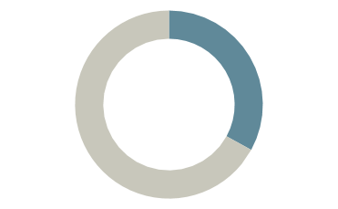


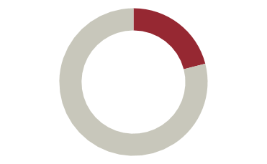

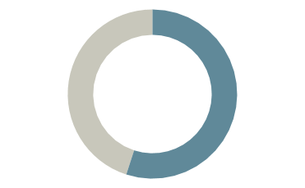
Data -> Insights: Top of Mind Issues for Success
33%
57%
50%
Have a Fully Deployed Analytics Solution Regional Banks – fully deployed data and analytics solution – with remaining considering, planning or trialing.
See Data Integration as a Barrier
Asset Managers said data integration across different data sources biggest barrier; 46% said accuracy and consistency
See Antiquated Tech as a Barrier
Insurers said inflexible legacy tech as a barrier to data and analytics success
21%
89%
55%
Ready for Analytics
Regional Banks who thought they were somewhat or very future ready with analytics
Have Difficulty Integrating Data
Asset managers had data integration difficulties.
Generating Smart, Cost-effective Outcomes
Insurers– said budget prioritization Is critical to success of implementation.
Sources: ICT/Ovum, Cornerstone, EY, RGA, Acuity, SMA

Slide 9
Based on Data From Multiple, Complex, Core Systems – Internal
Core Internal Systems
Trading | CRM | Core Processing
Payments | Risk | Compliance
Wealth Management | Clearing Settlement | Claims/Policy Management
Loan Servicing Platforms | Master Data Management | Market Data
Aladdin
Bloomberg
Custom
State Street
Custom
iPreo
Salesforce
Finastra
Fiserv
Jack Henry
Temenos
Charles River
Eagle Investment
SS&C
Apex
BNY Mellon
JP Morgan Clearing
Duck Creek
Guidewire
Insurity
Finastra
FIS
Fiserv
NCR
Axioma Big 3 Acct
MSCI
NICE Actimize SAS
Verafin
Black Knight
MeridianLink
NetOxygen
Collibra
IHS Markit
Bloomberg
Factset
Refinitiv
(Examples, not Exhaustive)
Transactional data drives future analytics.

Slide 10
Example Core Systems Across Industry Groups
Capital Markets
Banks
Insurance
Blackrock Aladdin (Trading, Risk Mgmt)
IHS Markit EDM
Bloomberg
Factset
Refinitiv
NICE Actimize
SAS, Risk Models
Axioma, MSCI (Barra)
Trading Systems - Various
Excel
Clearing and Settlement (Pershing)
Transfer Services
Fiserv DNA
Temenos
MeridianLink
Black Knight
Symitar and Episys (Jack Henry)
FIS
Abrigo (Risk)
Verafin (Risk)
Finacle (Infosys)
Oracle Flexcube/OBP
KONY
Finastra
NCR
SAP
Guidewire
Duck Creek
Majesco
Insurity
Britecore
Insuresoft
Policy and Claims
Billing Management
Applied Epic
Insurtech Providers

Slide 11
Growing Alternative Data Trend Is Already Here Enrich Core Data to Unveil New Insights
Web Traffic | Credit Card/ Debit Card | Carbon Reporting Data | Satellite/ Geospatial | Weather & Disasters | Mobile App Telemetry
Foot Traffic | IoT / Sensor Data | Social Sentiment | Survey Outcomes | Environmental Sustainability & Governance | Employment / Unemployment
Government Bureau of Labor Statistics | Real Estate Values | Search Terms | Oil and Gas Production and Reserves | Retail POS | Shipping Capacity, Forwarding, Containers

Slide 12
Continuous Agility Drives Transformational Growth
Requires a Modern Direct Data Platform
Accommodate and integrate legacy systems
Adopt modern transformative technology
Embrace cloud solutions and deployments
Continually optimize by simplifying complexity
Continuous Agility
Business Optimization
Optimized business processes go beyond mirroring marketplace realities
A Direct Data Platform fuels continuous reinvention and business agility by simplifying how teams across the organization and enterprise make empowered decisions
Cloud Solutions
Business strategy requires the new-found ability to not just react and respond, but to predict and recommend Optimization requires simplification or unification of heterogeneous systems and empowering data science.
Digital Transformation
Legacy Systems
Ease of adoption supports information technology agility while lowering the total cost of ownership
Actively pursue enterprise technology modernization so as to maximize transformation
Deprecated technology, but functioning as system of record

Slide 13
Data -> Insights Delivery
Three Significant Challenges
CHALLENGES
RESULTS
Zero flexibility as dynamic needs change
Continuous cost burden to manage data and build new data value
1
Complex, Disparate Data Across Multiple Source Systems
+
2
Front, Middle, and Back Office varying requirements
3
IT Resources and Budget required for ”Data OPD”
Notes:
OPD = Organize, Package and Deliver

Slide 14
Incorta Delivers Direct Value Across the Enterprise
Back
Office
Middle
Office
Front Office
Administrative, Support, Payments Processing (Clearing & Settlement)
Risk Management, Regulatory Compliance, IT, Support
Sales, Trading, Research, CLO, CMO, Portfolio Managers, Analysts, Investment Group
ABOR
Investment Reporting
HR Reporting - Peoplesoft
FP&A Reporting
AP, AR Analytics
AML analytics from NICE Actimize Source system
Regulatory Compliance Reporting
IBOR
Client Profitability
COVID Readiness
Risk – Operational, Financial, Technical
Investment Research
Customer 360 – “Beyond CRM”
Portfolio Management – Portfolio Analytics
Factor Investing
PBOR, IBOR
Next Best Conversation

Slide 15



Business Impact with Incorta
Revenue --> Profitability
Efficiency and Productivity
Insuring Future
Enhance Revenue/Alpha generation process
Incremental revenue from better product insights
Right Level of Effort to Right Client
Higher client retention through improving client experience
Improved AML, regulatory and compliance efforts
Lowering data and analytics implementation costs
Reducing regulatory reporting burden
Lower external and internal audit cost
Reduce IT dependence
Increasing availability of data with full fidelity and security
Lower ongoing people and system cost for data analytics (i.e. operational reporting)
Reduced data storage, ingestion, transformation and modeling costs

Slide 16
Incorta Technical Architecture

Slide 17

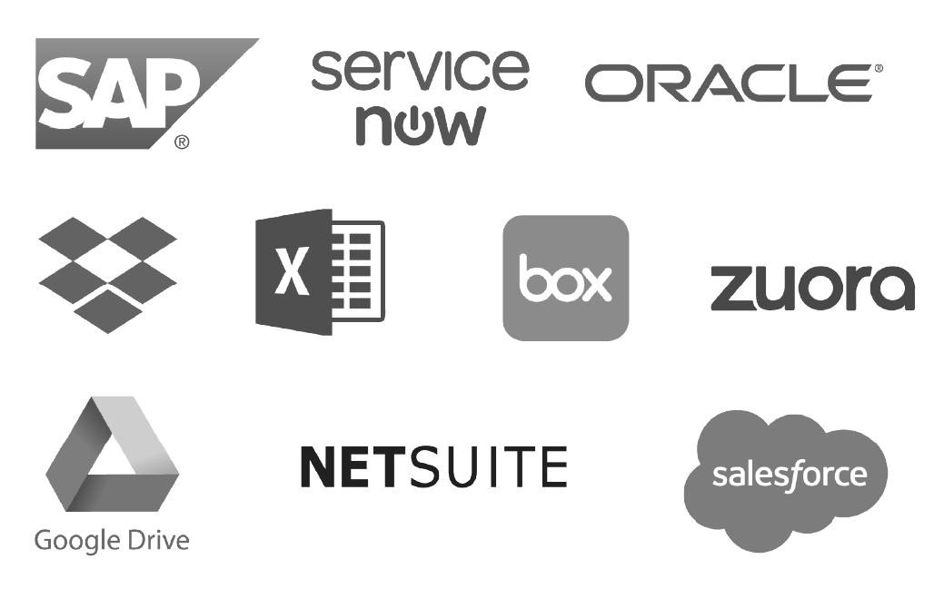



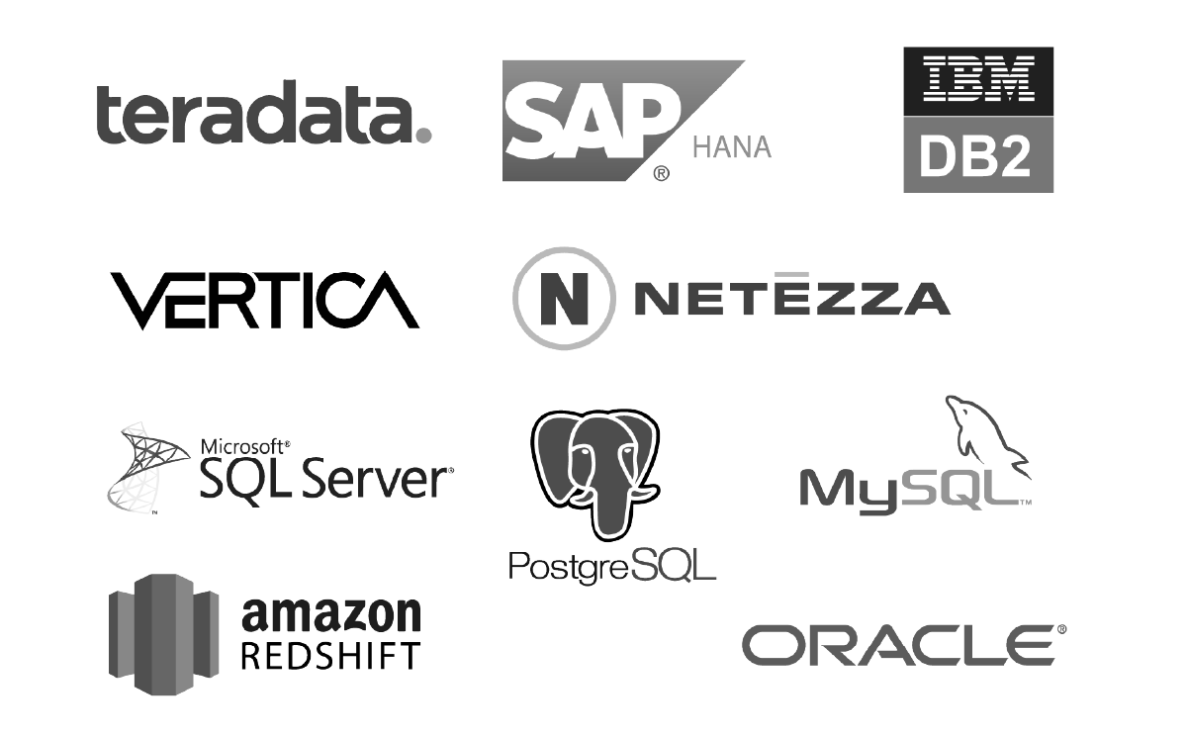



Incorta - Unified Data Analytics Platform
Applications
Data Consumer
The Direct Data Platform™
EDW & Databases
Data Analyst
Data Acquisition
Data Enrichment
Data Analytics
Big Data
Data Scientist
Data Lake, Shared Storage
Cloud, Hybrid, or On-Premises

Slide 18
Why Incorta?
Speed Of |  | Traditional Vendors
Drill down | Instant transaction- level detail | Limited to subsets. No transaction-level detail.
Rendering reports | Sub-second from click | Minutes (or hours or days)
Adding new data | Minutes to add new sources | Weeks to build the connections and remodel
Getting accurate results | Instant. No reshaping means accurate results. | Who knows? Transformed data means errors.

Slide 19




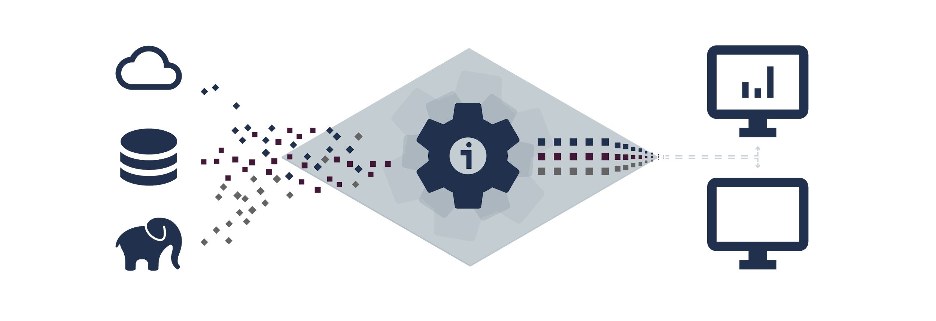




Incorta Architecture
Powered by Direct Data Mapping
Incorta Direct Data Platform
Direct Data Acquisition
Direct Data Management
Direct Data Analytics
Data Connectors
Parallel Data Loader
Schema Loading &
Inspection
Memory Optimized Analytics
Engine
Data Exploration & Publishing
DIRECT
DATA MAPPING
Materialized Views
Notebooks
Enterprise Security
Open Interfaces
SQL, SDK, API, CLI
Orchestration & Notifications
Machine Learning
Metadata: Schema, Catalog, Data Lineage
Parquet Data Lake
Direct Data Map
(Transaction-level Data, Columnar, Supports Upserts)
“Smart Data Lake” on Shared Storage / Cloud Data Lake Storage

